Slide 2
solve problems based on rate computation.

Slide 3
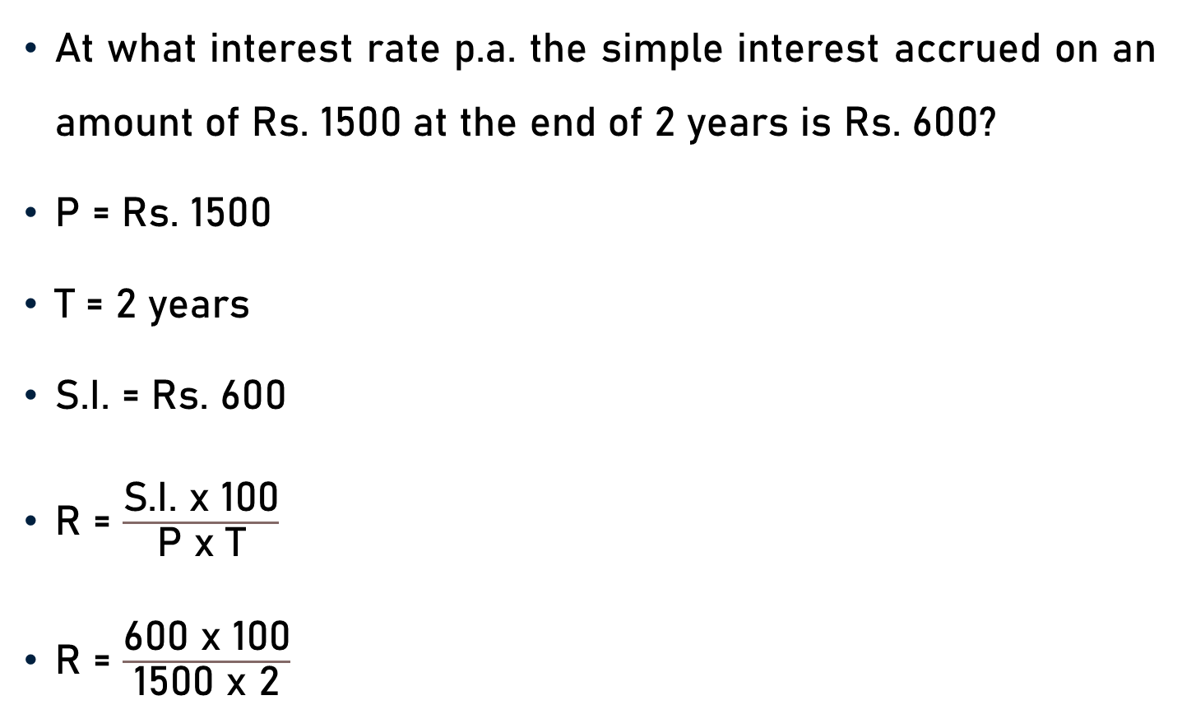
Problem 1
At what interest rate p.a. the simple interest accrued on an amount of Rs. 1500 at the end of 2 years is Rs. 600?
P = Rs. 1500
T = 2 years
S.I. = Rs. 600
R = $\frac{\text{S}\text{.}\text{I}\text{.} \text{x}\text{ 100}}{\text{P} \text{x} \text{T}}$
R = $\frac{\text{600 }\text{x}\text{ 100}}{\text{1500} \text{x}\text{ 2}}$

Slide 4

Problem 1
R = $\frac{\text{S}\text{.}\text{I}\text{.} \text{x}\text{ 100}}{\text{P} \text{x} \text{T}}$
R = $\frac{\text{600 }\text{x}\text{ 100}}{\text{1500} \text{x}\text{ 2}}$
R = $\frac{\text{600 }\text{x}\text{ 100}}{\text{1500} \text{x}\text{ 2}}$
R = 20%
2
20
5

Slide 5
Problem 2
At what interest rate p.a., in 4 years, a sum of Rs. 2000 will become Rs. 4000?
P = Rs. 2000
A = Rs. 4000
T = 4 years
S.I. = A − P
S.I. = Rs. (4000 − 2000)
S.I. = Rs. 2000

Slide 6

Problem 2
S.I. = Rs. 2000, T = 4 years, P = Rs. 2000, and R = ?
$\text{R}$ = $\frac{\text{S}\text{.}\text{I}\text{. }\text{x}\text{ 100}}{\text{P} \text{x} \text{T}}$
R = $\frac{\text{2000} \text{x}\text{ 100}}{\text{2000} \text{x}\text{ 4 }}$
R = 25 % p.a.
25

Slide 7
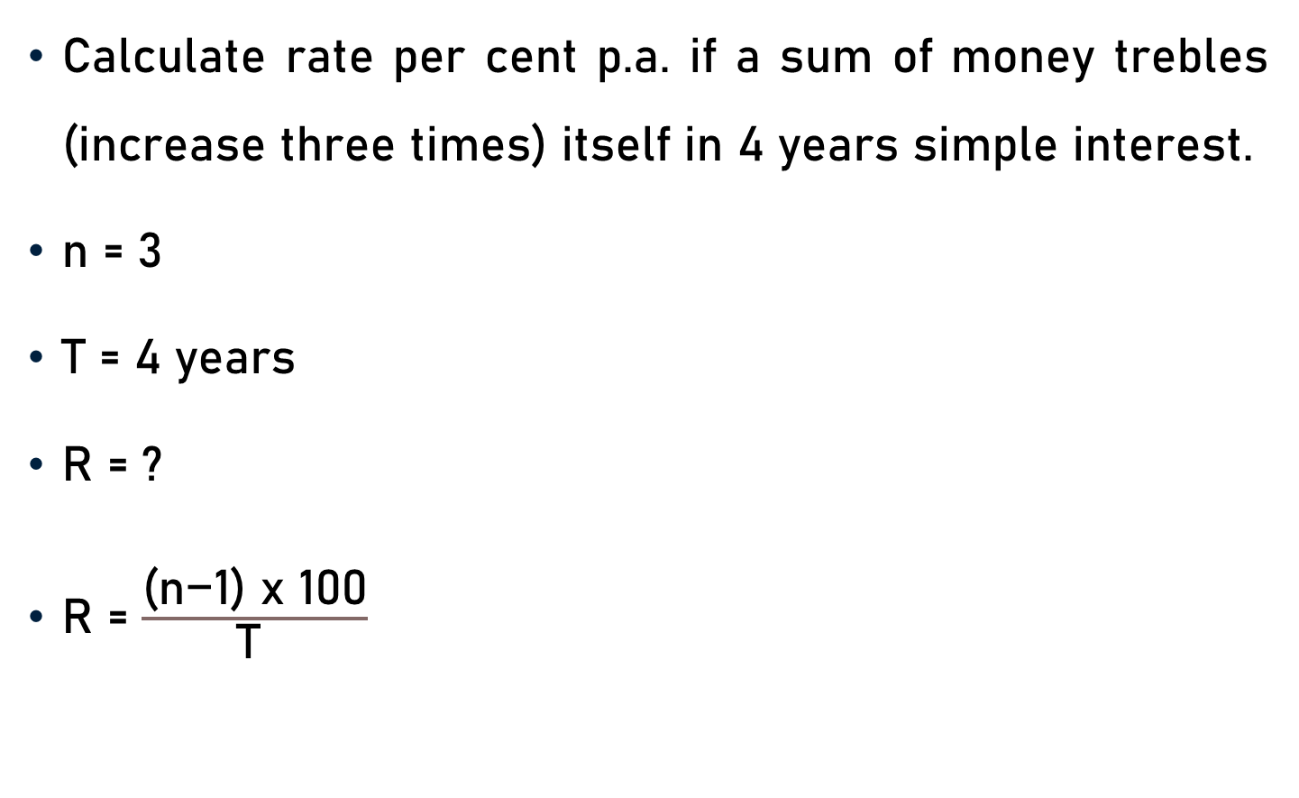
Problem 3
Calculate rate per cent p.a. if a sum of money trebles (increase three times) itself in 4 years simple interest.
n = 3
T = 4 years
R = ?
$\text{R}$ = $\frac{\text{(}\text{n}\text{−1) }\text{x}\text{ 100}}{\text{T} }$

Slide 8

Problem 3
n = 3, T = 4 years, and R = ?
$\text{R}$ = $\frac{\text{(}\text{n}\text{−1) }\text{x}\text{ 100}}{\text{T} }$
$\text{R}$ = $\frac{\text{(}\text{3}\text{−1) }\text{x}\text{ 100}}{\text{4} }$
$\text{R}$ = $\frac{\text{(2) }\text{x}\text{ 100}}{\text{4 }}$
R = 50 % p.a.
50
2

Slide 9
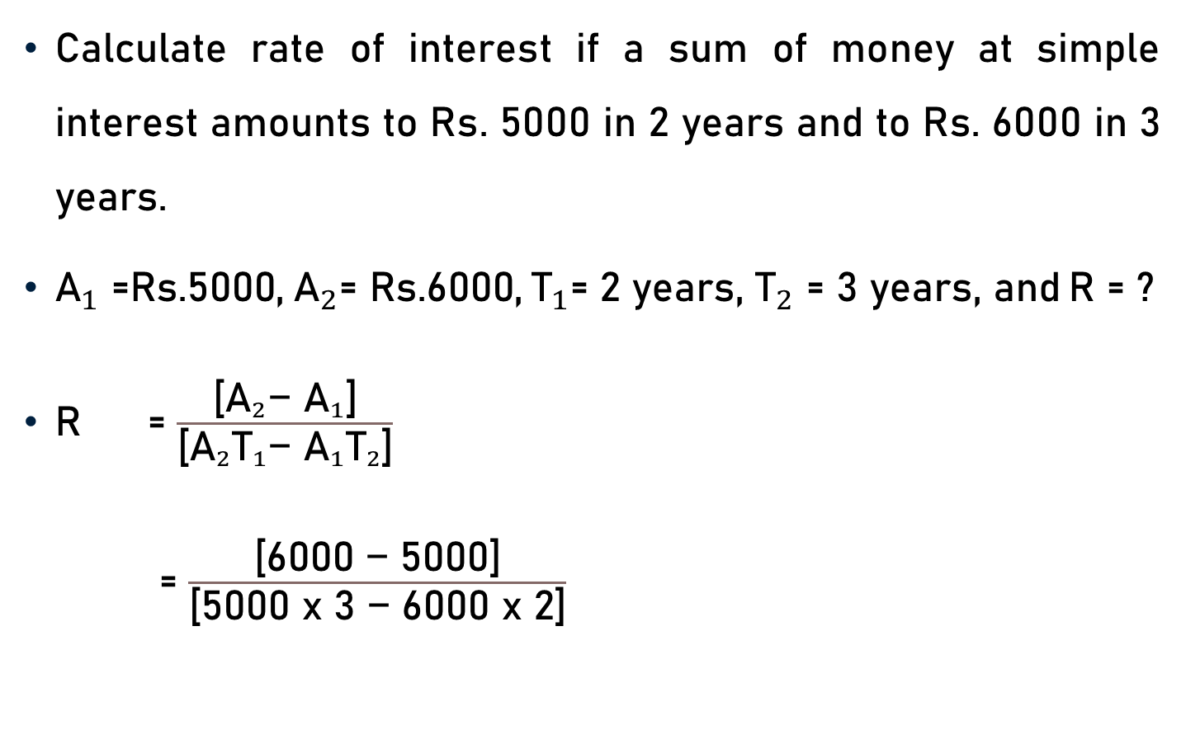
Problem 4
Calculate rate of interest if a sum of money at simple interest amounts to Rs. 5000 in 2 years and to Rs. 6000 in 3 years.
${\text{A}}_{1}{\text{=}\text{Rs}\text{.5000,} { \text{A}}_{2}\text{=} \text{Rs}\text{.6000,}{ \text{T}}_{1}\text{=}\text{ 2 }\text{years}\text{, }\text{T}}_{2}\text{=}$ $\text{3} \text{years}\text{, }\text{and}$ $\text{R}\text{ = ?}$
$\text{R}$ = $\frac{\text{[}{{\text{A}}_{2}\text{−} \text{A}}_{1}\text{]}}{\text{[}{\text{A}}_{2}{\text{T}}_{1}\text{−} {{\text{A}}_{1}\text{T}}_{2}\text{]}}$
= $\frac{\text{[6000 }\text{−} \text{5}\text{000]}}{\text{[5000 }\text{x}\text{ 3 }\text{−}\text{ 6000 }\text{x}\text{ 2]}}$

Slide 10
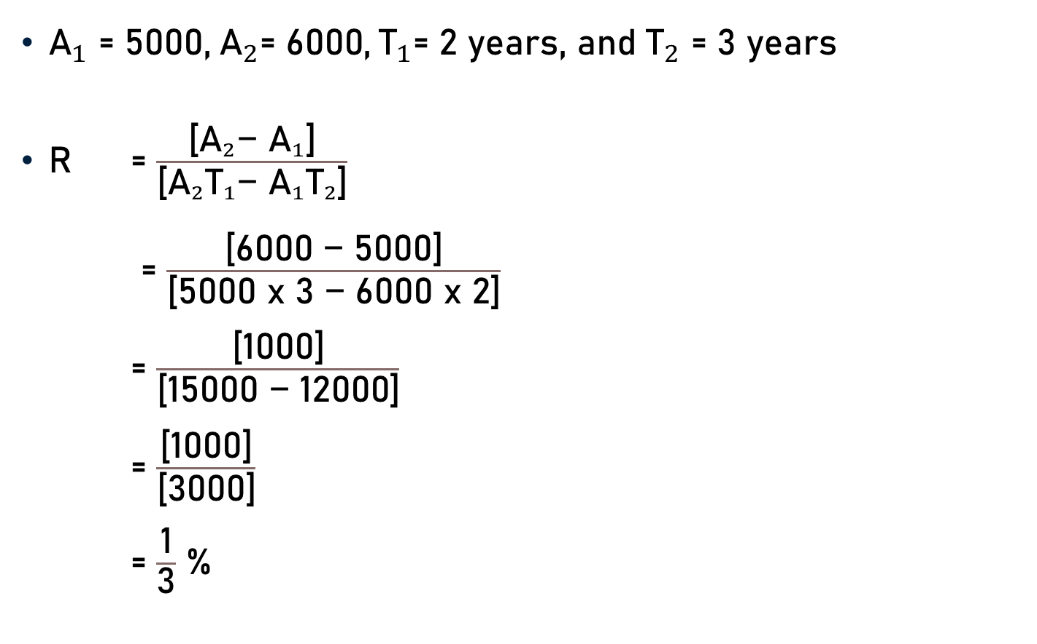
Problem 4
${\text{A}}_{1}{\text{= }\text{5}\text{000,} { \text{A}}_{2}\text{= 6000,}{ \text{T}}_{1}\text{= 2 }\text{years}\text{, }\text{and} \text{T}}_{2}\text{= 3 }\text{years}$
$\text{R}$ = $\frac{\text{[}{{\text{A}}_{2}\text{−} \text{A}}_{1}\text{]}}{\text{[}{\text{A}}_{2}{\text{T}}_{1}\text{−} {{\text{A}}_{1}\text{T}}_{2}\text{]}}$
= $\frac{\text{[}\text{6000 }\text{−}\text{ 5}\text{000]}}{\text{[5000 }\text{x}\text{ 3 }\text{−}\text{ 6000 }\text{x}\text{ 2]}}$
= $\frac{\text{[}\text{1}\text{000]}}{\text{[}\text{1}\text{5000 }\text{−} \text{12}\text{000]}}$
= $\frac{\text{[}\text{1}\text{000]}}{\text{[}\text{3000}\text{]}}$
= $\frac{\text{1}}{\text{3}}$ %
1
3

Slide 11
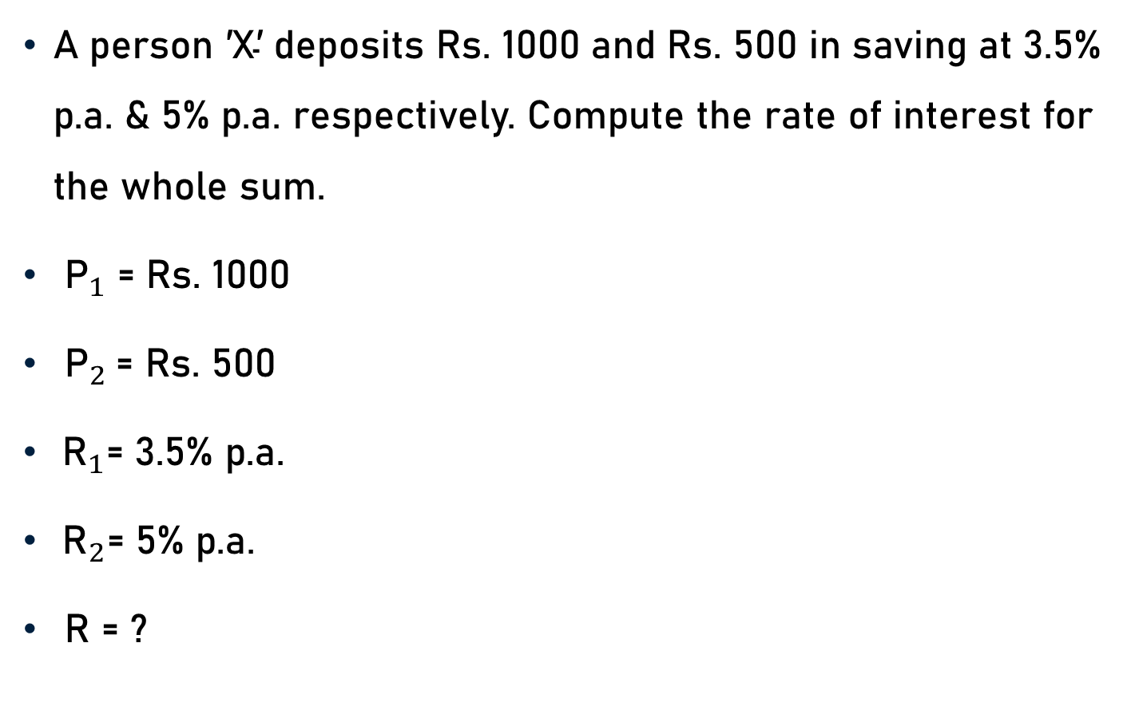
Problem 5
$\text{A} \text{person}\text{ ′}\text{X}\text{′ }\text{deposits} \text{Rs}\text{. 1000 }\text{and} \text{Rs}\text{. 500 }\text{in} \text{saving} \text{at}\text{ 3.5\% }\text{p}\text{.}\text{a}\text{.} \text{\& 5}\text{\% }\text{p}\text{.}\text{a}\text{. }\text{respectively}\text{. }\text{Compute} \text{the} \text{rate} \text{of} \text{interest} \text{for} \text{the} \text{whole} \text{sum}\text{.}$
${\text{P}}_{1}$ $\text{= }\text{Rs}\text{. 1000}$
${\text{P}}_{2}$ $\text{= }\text{Rs}\text{. 500}$
${ \text{R}}_{1}\text{= 3.5\% }\text{p}\text{.}\text{a}\text{. }$
${ \text{R}}_{2}\text{= 5\% }\text{p}\text{.}\text{a}\text{.}$
$\text{R}\text{ = ?}$

Slide 12
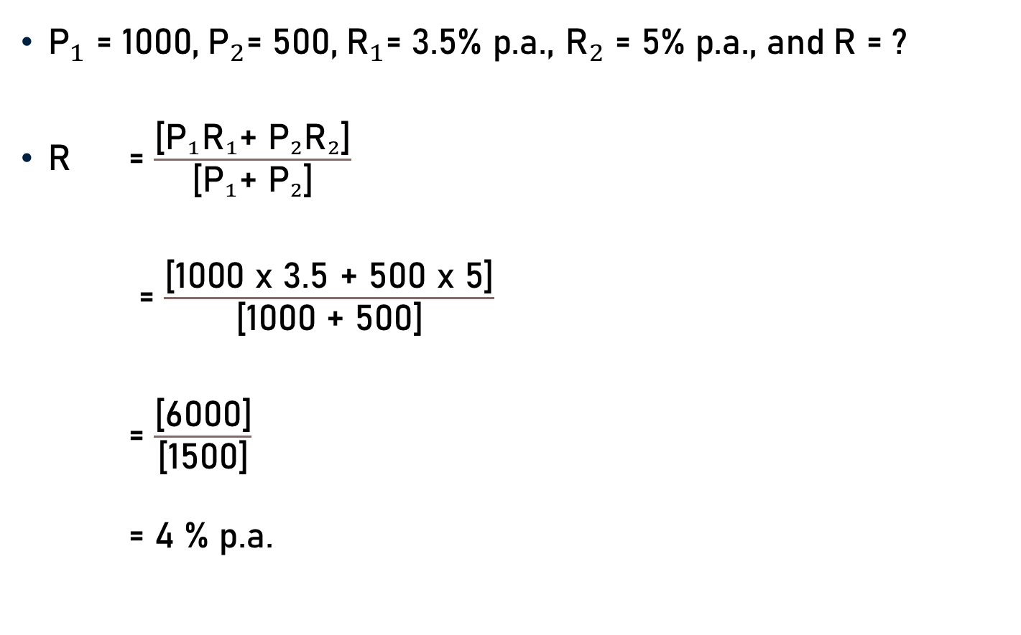
Problem 5
${\text{P}}_{1}{\text{= }\text{10}\text{00,} { \text{P}}_{2}\text{= }\text{5}\text{00,}{ \text{R}}_{1}\text{= }\text{3.5}\text{\% }\text{p}\text{.}\text{a}\text{., }\text{R}}_{2}\text{= }\text{5}\text{\% }\text{p}\text{.}\text{a}\text{.,}$ $\text{and}$ $\text{R}\text{ = ?}$
$\text{R}$ = $\frac{\text{[}{\text{P}}_{1}{\text{R}}_{1}\text{+ }{\text{P}}_{2}{\text{R}}_{2}\text{]}}{\text{[}{\text{P}}_{1}\text{+} {\text{P}}_{2}\text{]}}$
= $\frac{\text{[}\text{1000 }\text{x}\text{ 3.5 + 500 }\text{x}\text{ 5]}}{\text{[}\text{10}\text{00 }\text{+} \text{5}\text{00]}}$
= $\frac{\text{[}\text{60}\text{00]}}{\text{[}\text{1500}\text{]}}$
= 4 % p.a.
4
1

Slide 13
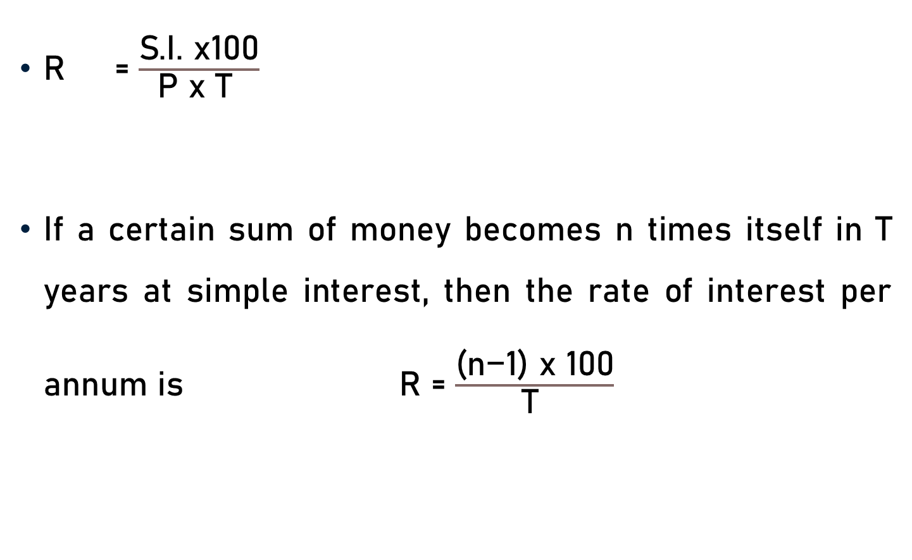
Conclusion
R = $\frac{\text{S}\text{.}\text{I}\text{. }\text{x}\text{100}}{\text{P} \text{x} \text{T} }$
If a certain sum of money becomes n times itself in T years at simple interest, then the rate of interest per annum is $\text{R}$ = $\frac{\text{(}\text{n}\text{−1) }\text{x}\text{ 100}}{\text{T} }$

Slide 14
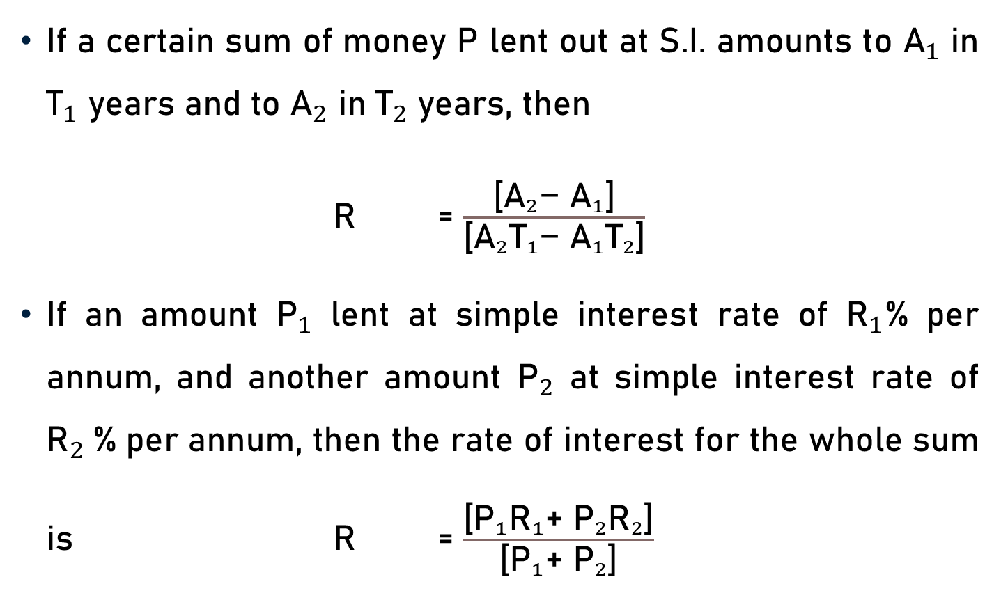
Conclusion
If a certain sum of money P lent out at S.I. amounts to ${\text{A}}_{1}$ in ${\text{T}}_{1}$ years and to ${\text{A}}_{2}$ in ${\text{T}}_{2}$ years, then
$\text{R}$ = $\frac{\text{[}{{\text{A}}_{2}\text{−} \text{A}}_{1}\text{]}}{\text{[}{\text{A}}_{2}{\text{T}}_{1}\text{−} {{\text{A}}_{1}\text{T}}_{2}\text{]}}$
If an amount ${\text{P}}_{1}$ lent at simple interest rate of ${\text{R}}_{1}$% per annum, and another amount ${\text{P}}_{2}$ at simple interest rate of ${\text{R}}_{2}$% per annum, then the rate of interest for the whole sum is $\text{R}$ = $\frac{\text{[}{\text{P}}_{1}{\text{R}}_{1}\text{+ }{\text{P}}_{2}{\text{R}}_{2}\text{]}}{\text{[}{\text{P}}_{1}\text{+ }{\text{P}}_{2}\text{]}}$

Slide 15
Summary
Computation of Rate

